Slide 1
LDD
BHAVANA
DAY 24
07/05/2024

Slide 2
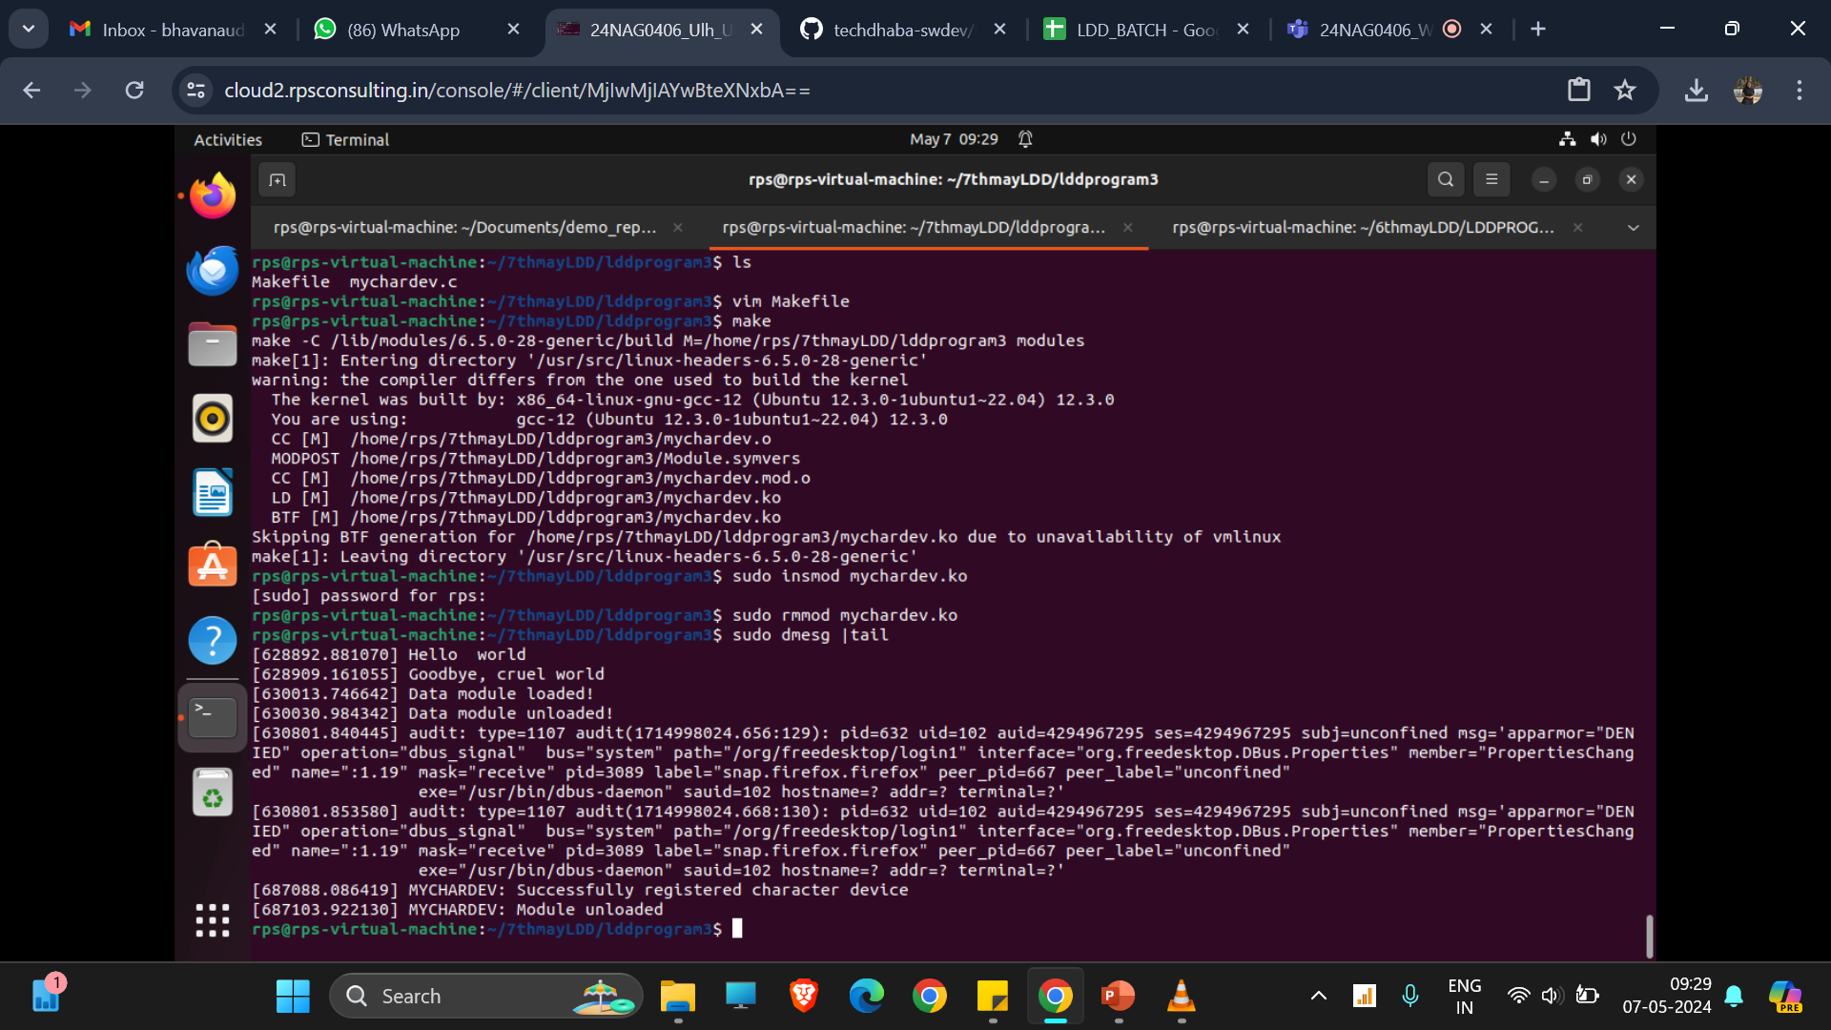
COMPILING A LDD PROGRAM:

Slide 3
What’s a ‘device-driver’?
A special kind of computer program
Intended to control a peripheral device
Needs to execute ‘privileged’ instructions
Must be integrated into the OS kernel
Interfaces both to kernel and to hardware
Program-format specific to a particular OS

Slide 4
Linux device-drivers
A package mainly of ‘service functions’
The package is conceptually an ‘object’
But in C this means it’s a ‘struct’
Specifically: struct file_operations { …; };
Definition is found in a kernel-header:
‘/usr/src/linux/include/linux/fs.h’

Slide 5
Types of Device-Drivers
Character drivers:
- the device processes individual bytes
(e.g., keyboard, printer, modem)
Block drivers:
- the device processes groups of bytes
(e.g., hard disks, CD-ROM drives)

Slide 6
Linux has other driver-types
Network drivers
Mouse drivers
SCSI drivers
USB drivers
Video drivers
‘Hot-swap’ drivers
… and others

Slide 7
Developing a device-driver
Clarify your requirements
Devise a design to achieve them
Test your design-concept (‘prototype’)
‘Debug’ your prototype (as needed)
Build your final driver iteratively
Document your work for future use

Slide 8
‘Open Source’ Hardware
Some equipment manufactures regard their designs as ‘intellectual property’
They don’t want to ‘give away’ their info
They believe ‘secrecy’ is an advantage
They fear others might copy their designs
BUT: This hinders systems programmers!

Slide 9
Non-Disclosure Agreements
Sometimes manufacturers will let ‘trusted’
individuals, or commercial ‘partners’, look
at their design-specs and manuals
College professors often are ‘trusted’
BUT: Just to be sure, an NDA is required
-- which prevents professors from teaching
students the design-details that they learn

Slide 10
Some designs are ‘open’
The IBM-PC designs were published
Then other companies copied them
And those companies prospered!
While IBM lost market-share!
An unfortunate ‘lesson’ was learned

Slide 11
Advantage of ‘open’ designs
Microsoft and Apple used to provide lots
of technical information to programmers
They wanted to encourage innovations
that made their products more valuable
Imagine hundreds of unpaid ‘volunteers’
creating applications for your platform!
BUT: Were they ‘giving away the store’?

Slide 12
A ‘virtual device’
To avoid NDA hassles, we can work with a ‘pseudo’ device (i.e., no special hardware)
We can use a portion of physical memory to hold some data that we ‘read’ or ‘write’
We refer to our pseudo-device as a ‘stash’
This allows us to illustrate the main issues that a simple device-driver will encounter

Slide 13
How system-calls work
Operating System
Kernel
C Runtime Library
Application Program
Device Driver
User-space
Kernel-space

Slide 14
How a ring buffer works
where to put the next data-element
tail
data
data
data
head
where to get the next data-element

Slide 15
Linux treats devices as files
Programmers accustomed to the file API
open(), lseek(), read(), write(), close(), ...
Requires creating a filename in a directory
(special ‘/dev’ directory is for devices)

Slide 16
Driver Identification
Character/Block drivers:
Use ‘major-number’ to identify the driver
Use ‘minor-numbers’ to distinguish among
several devices the same driver controls
Kernel also needs a driver-name
Users need a device-node as ‘interface’

Slide 17
Our module: ‘stash.c’
We can create a device-driver module for our ‘virtual’ device (we named it ‘stash’)
It allows an application to save some data in a kernel-space buffer (a ‘ring’ buffer) by ‘writing’ to the device-file ‘/dev/stash’
Any application can retrieve this stashed data, by reading from this device-file
It works like a FIFO (First In, First Out)

Slide 18
Creating our device node
The ‘mknod’ command creates the node: $ mknod /dev/stash c 40 0
The ‘chmod’ command changes the node access-permissions (if that’s needed): $ chmod a+rw /dev/stash
Both commands normally are ‘privileged’

Slide 19
Module ‘Boilerplate’
Must have ‘init_module()’ function
(to ‘register’ service-functions with kernel)
Must have ‘cleanup_module()’ function
(to ‘unregister’ our service-functions)

Slide 20
More ‘boilerplate’
Must include certain kernel header-files
(e.g., #include <linux/module.h>)
Must define certain compiler constants
(e.g., #define __KERNEL__, MODULE)
Alternatively these constants may be defined on the compiler’s command-line (using –D switch), and so be conveniently embedded in a Makefile

Slide 21
Important File I/O Functions
int open( char *pathname, int flags );
int read( int fd, void *buf, size_t count );
int write( int fd, void *buf, size_t count );
loff_t lseek( int fd, loff_t off, int whence );
int close( int fd );

Slide 22
UNIX ‘man’ pages
A convenient online guide to prototypes and semantics of the C Library Functions
Example of usage:
$ man 2 open

Slide 23
The ‘open’ function
#include <fcntl.h>
int open( const char *pathname, int flags );
Converts a pathname to a file-descriptor
File-descriptor is a nonnegative integer
Used as a file-ID in subsequent functions
‘flags’ is a symbolic constant:
O_RDONLY, O_WRONLY, O_RDWR

Slide 24
The ‘close’ function
#include <unistd.h>
int close( int fd );
Breaks link between file and file-descriptor
Returns 0 on success, or -1 if an error

Slide 25
The ‘read’ function
#include <unistd.h>
int read( int fd, void *buf, size_t count );
Attempts to read up to ‘count’ bytes
Bytes are placed in ‘buf’ memory-buffer
Returns the number of bytes read
Or returns -1 if some error occurred
Return-value 0 means ‘end-of-file’

Slide 26
The ‘write’ function
#include <unistd.h>
int write( int fd, void *buf, size_t count );
Attempts to write up to ‘count’ bytes
Bytes are taken from ‘buf’ memory-buffer
Returns the number of bytes written
Or returns -1 if some error occurred
Return-value 0 means no data was written

Slide 27
The ‘lseek’ function
#include <unistd.h>
loff_t lseek( int fd, loff_t off, int whence );
This function moves the file’s pointer
Three ways to do the move:
SEEK_SET: move from beginning position
SEEK_CUR: move from current position
SEEK_END: move from ending position
(Could be used to determine a file’s size)

Slide 28
Default is ‘Blocking’ Mode
The ‘read()’ function normally does not return 0 (unless ‘end-of-file’ is reached)
The ‘write()’ function normally does not return 0 (unless there’s no more space)
Instead, these functions ‘wait’ for data
But ‘busy-waiting’ would waste CPU time, so the kernel will put the task to ‘sleep’
This means it won’t get scheduled again (until the kernel ‘wakes up’ this task)

Slide 29
How multitasking works
Can be ‘cooperative’ or ‘preemptive’
‘interrupted’ doesn’t mean ‘preempted’
‘preempted’ implies a task was switched

Slide 30
Tasks have various ‘states’
A task may be ‘running’
A task may be ‘ready-to-run’
A task may be ‘blocked’

Slide 31
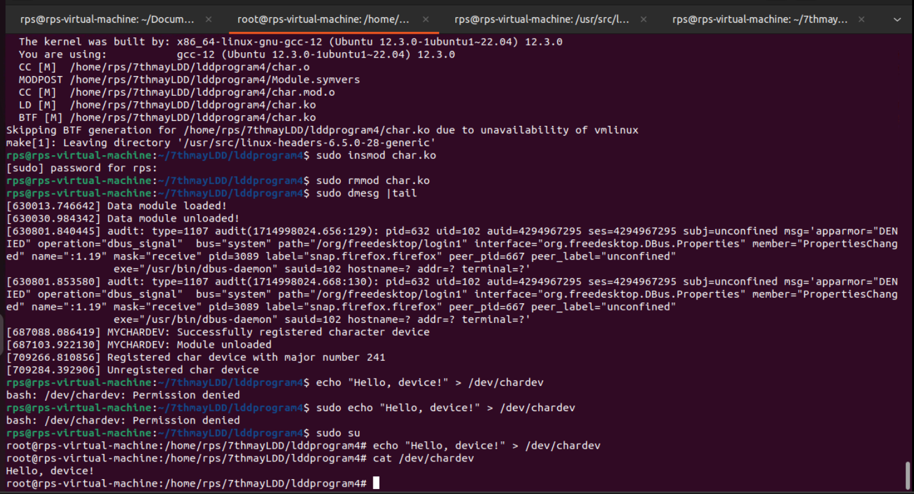
INTERACTING WITH KERNAL

Slide 32
1. The echo command is used to print the specified string to the standard output.2. The > operator redirects the output of the echo command to the specified file, which in this case is /dev/chardev.3. The kernel receives the write request to the /dev/chardev character device.4. The kernel invokes the device_write function in the kernel module associated with /dev/chardev.5. The device_write function copies the string "Hello, device!" from user space to the message buffer (msg) in kernel space.6. The kernel module then processes the data as per its implementation, which in this case may involve further processing or handling of the message.7. The write operation completes, and if successful, the command finishes execution without any explicit output.

Slide 33
Kernel manages tasks
Kernel uses ‘queues’ to manage tasks
A queue of tasks that are ‘ready-to-run’
Other queues for tasks that are ‘blocked’

Slide 34
Special ‘wait’ queues
Needed to avoid wasteful ‘busy waiting’
So Device-Drivers can put tasks to sleep
And Drivers can ‘wake up’ sleeping tasks

Slide 35
How to use Linux wait-queues
#include <linux/sched.h>
wait_queue_head_t my_queue;
init_waitqueue_head( &my_queue );
sleep_on( &my_queue );
wake_up( &my_queue );
But can’t unload driver if task stays asleep!

Slide 36
‘interruptible’ wait-queues
Device-driver modules should use:
interruptible_sleep_on( &my_queue );
wake_up_interruptible( &my_queue );
Then tasks can be awakened by ‘signals’

Slide 37
How ‘sleep’ works
Our driver defines an instance of a kernel data-structure called a ‘wait queue head’
It will be the ‘anchor’ for a linked list of ‘task_struct’ objects
It will initially be an empty-list
If our driver wants to put a task to sleep, then its ‘task_struct’ will be taken off the runqueue and put onto our wait queue

Slide 38
How ‘wake up’ works
If our driver detects that a task it had put to sleep (because no data-transfer could be done immediately) would now be allowed to proceed, it can execute a ‘wake up’ on its wait queue object
All the task_struct objects that have been put onto that wait queue will be removed, and will be added to the CPU’s runqueue

Slide 39
Application to a ringbuffer
A first-in first-out data-structure (FIFO)
Uses a storage-array of finite length
Uses two array-indices: ‘head’ and ‘tail’
Data is added at the current ‘tail’ position
Data is removed from the ‘head’ position

Slide 40
Ringbuffer (continued)
One array-position is always left unused
Condition head == tail means “empty”
Condition tail == head-1 means “full”
Both ‘head’ and ‘tail’ will “wraparound”
Calculation: next = ( next+1 )%RINGSIZE;

Slide 41
‘write’ algorithm for ‘stash.c’
while ( ringbuffer_is_full )
{
interruptible_sleep_on( &wq );
If ( signal_pending( current ) ) return –EINTR;
}
Insert byte from user-space into ringbuffer;
wake_up_interruptible( &wq );
return 1;

Slide 42
‘read’ algorithm for ‘stash.c’
while ( ringbuffer_is_empty )
{
interruptible_sleep_on( &wq );
If ( signal_pending( current ) ) return –EINTR;
}
Remove byte from ringbuffer and store to user-space;
wake_up_interruptible( &wq );
return 1;

Slide 43
The other driver-methods
We can just omit definitions for other driver system-calls in this example (e.g., ‘open()’, ‘lseek()’, and ‘close()’) because suitable ‘default’ methods are available within the kernel for those cases in this example

Slide 44
Demonstration of ‘stash’
Quick demo: we can use I/O redirection
For demonstrating ‘write’ to /dev/stash:
$ echo “Hello” > /dev/stash
For demonstrating ‘read’ from /dev/stash:
$ cat /proc/stash

Slide 45
In-class exercise
Can you modify the ‘stash.c’ example, to make it more efficient (fewer system calls), by arranging for its ‘read’ and ‘write’ to do larger-size data transfers (i.e., more than just one byte at a time)?

